Slide 1


SoC Week 1 Hackathon
Spooky Mansion Escape Room👻
Serge Huleani
Sarah Hunt
Sami Azil
29th November 2024

Slide 2
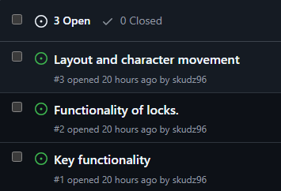

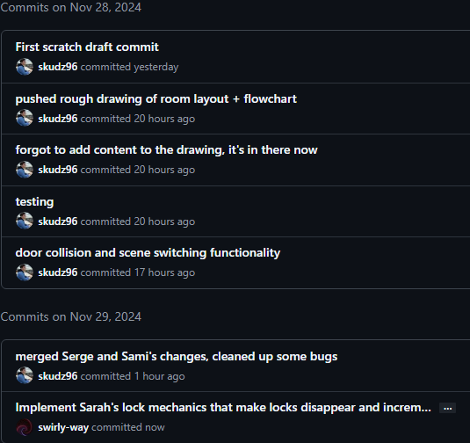
Reflection
AGILE Workflow:
Iterative development
Brief check-ins regarding progress in a Slack group we formed
Task ownership & collaboration. GitHub issues & assignments was great for this
Continuous feedback loop through consistent commits
Improvements for next time:
Caught up on design beyond first MVP. Keep it simple to start off with
Use a programming language we are all familiar with!
Lost original workflow file. Find out how to roll back files on GitHub
Push more regularly to have a clearer, pathed journey

Slide 3
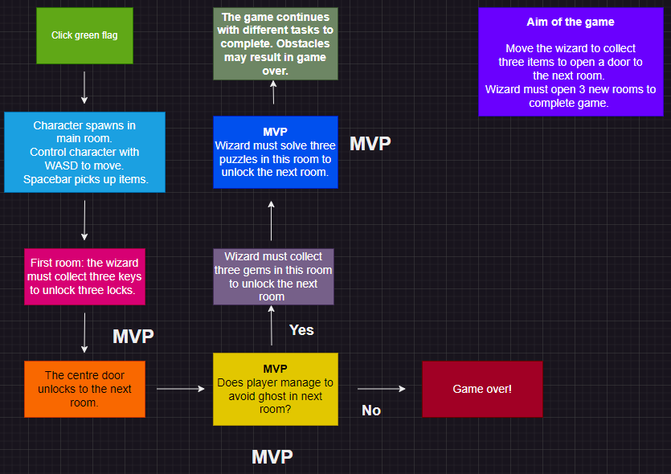
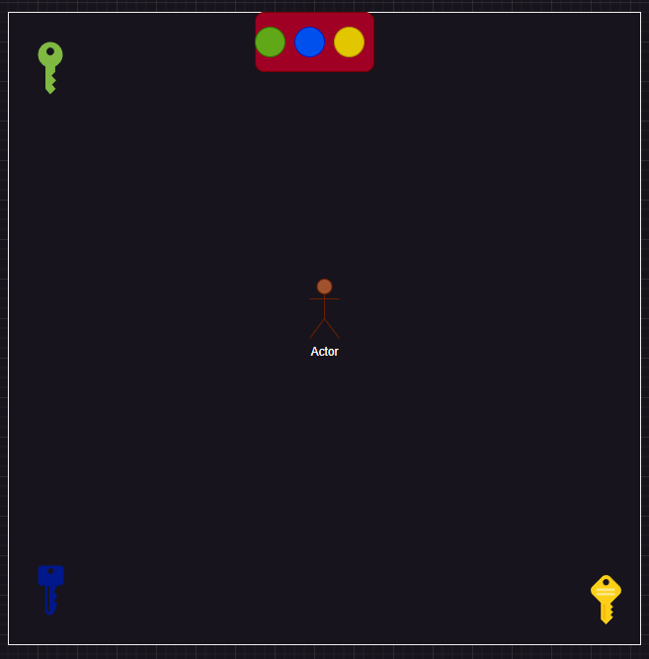
Flow diagram + MVPs

